Slide 1
2.4: Introduction to mixed-effects models
Learning objectives
Understand terminology for mixed-effect models
Understand when random effects are appropriate
Understand basic computational approach to mixed-effect models

Slide 2
Say we’re sampling fishes near Seattle
Know from GIS maps that we have 120 streams
Can only conduct 60 samples
Problems
Can’t sample every stream!
Have to deal with measurement errors
Might have covariates to include

Slide 3
Idea #1 (bad)
Randomly sample 60 streams (without replacement)
Figure out average count and extrapolate
Problems
Doesn’t account for measurement error
Confounds measurement errors and between-site variability

Slide 4
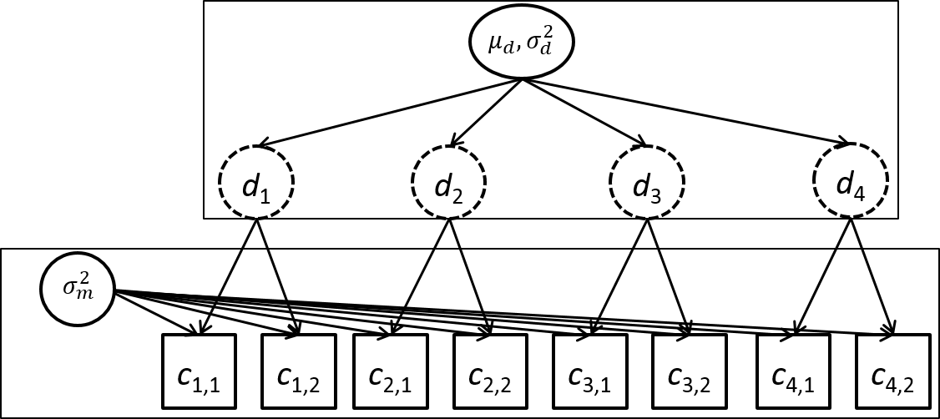
Idea #2 (better)
Randomly chose 30 streams (without replacement)
Sample each chosen stream twice
Benefits
Separately estimate measurement and between-site variability

Slide 5
Definitions
Term | Definition
Random effect | Coefficient that is “exchangeable” with one or more other coefficients
Hyperdistribution | Distribution for “exchangeable” random effects
Exchangeable | No information is available to distinguish between residual variability in random effects
Fixed effect | Coefficient that is not exchangeable with others, and which hence is estimated without a hyperdistribution
Mixed-effect model | Model with both fixed and random effects

Slide 6
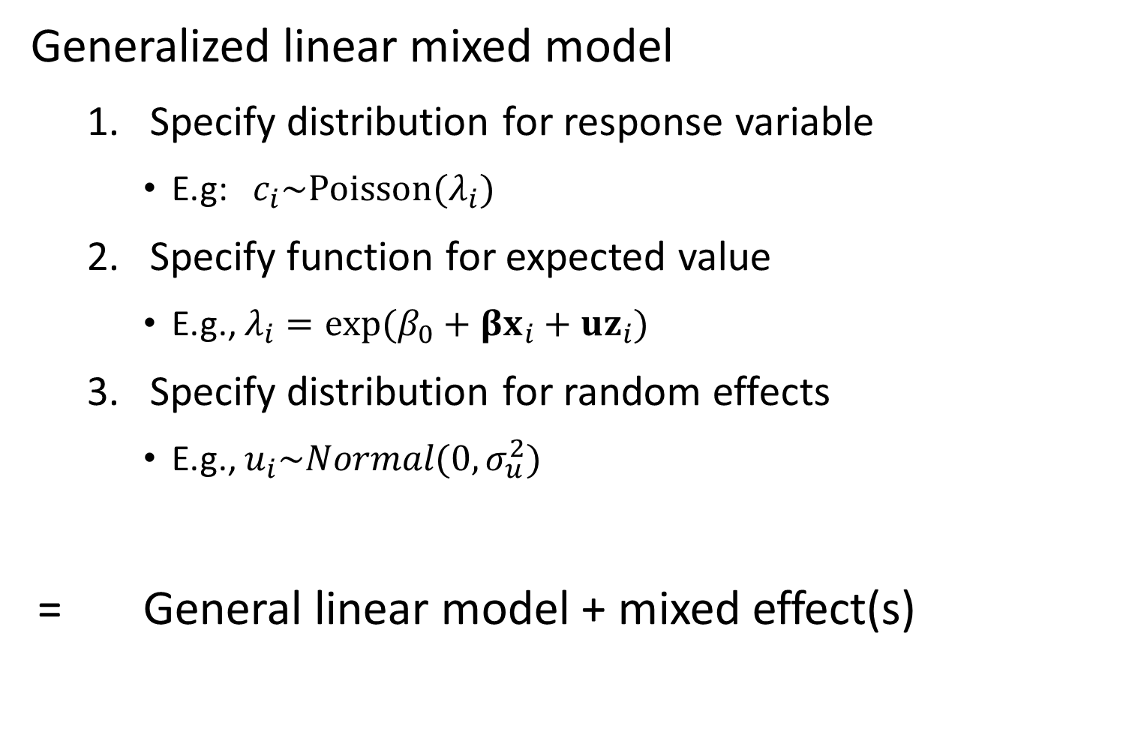
Generalized linear mixed model
Specify distribution for response variable
E.g: $c_{i}\sim Poisson(λ_{i})$
Specify function for expected value
E.g., $λ_{i}=exp⁡(β_{0}+βx_{i}+uz_{i})$
Specify distribution for random effects
E.g., $u_{i}\sim Normal(0,σ_{u}^{2})$
= General linear model + mixed effect(s)

Slide 7
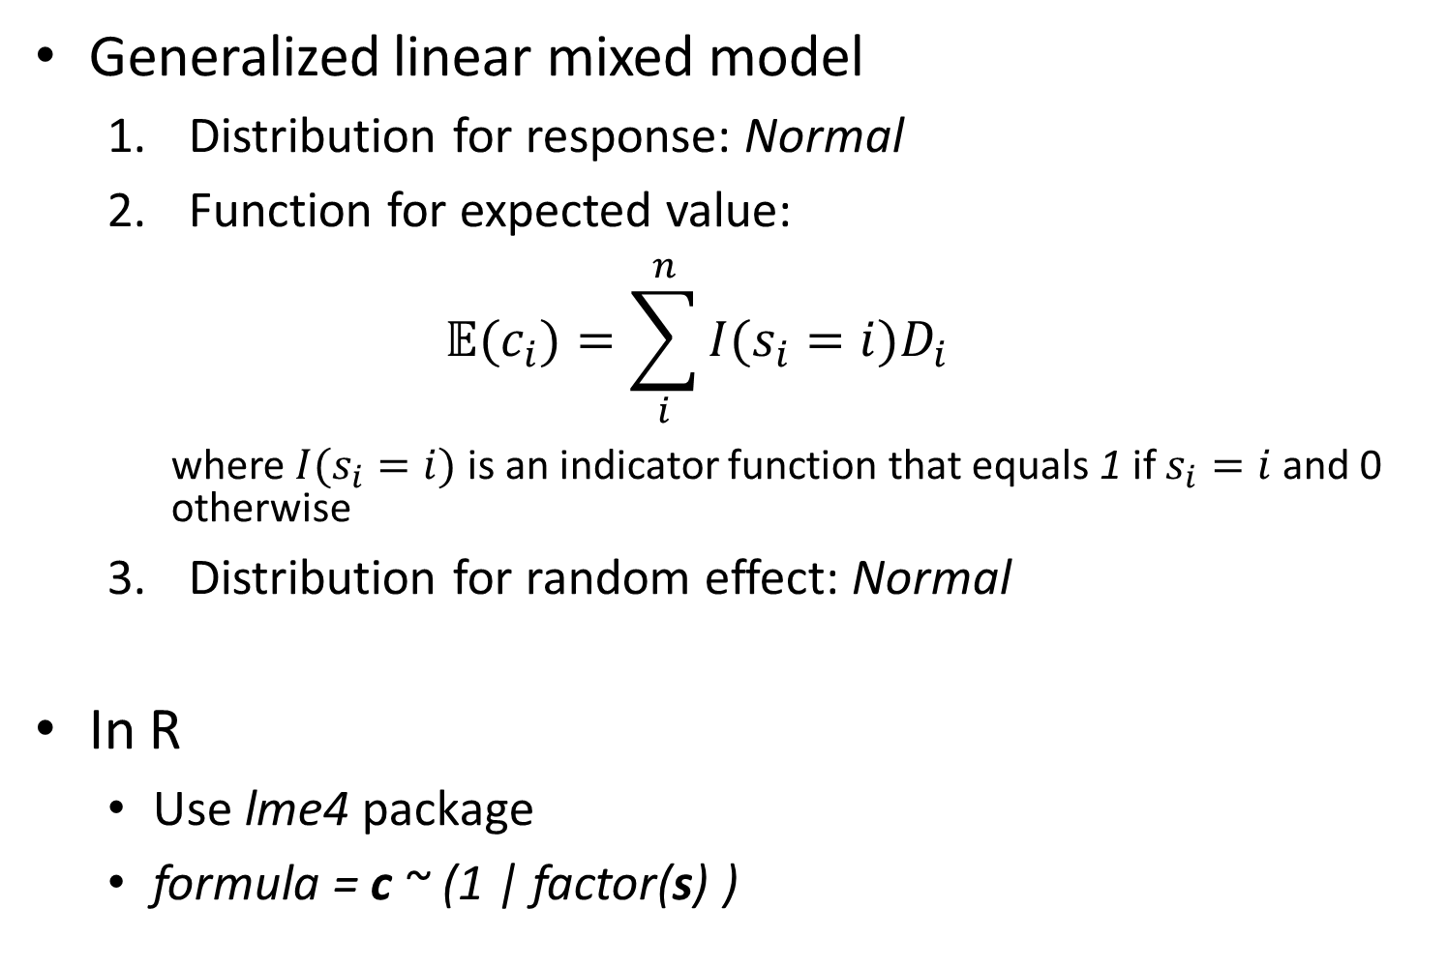
Generalized linear mixed model
Distribution for response: Normal
Function for expected value:
$$𝔼(c_{i})=\sum_{i}^{n}{I(s_{i}=i)D_{i}}$$
where $I(s_{i}=i)$ is an indicator function that equals 1 if $s_{i}=i$ and 0 otherwise
Distribution for random effect: Normal
In R
Use lme4 package
formula = c ~ (1 | factor(s) )

Slide 8
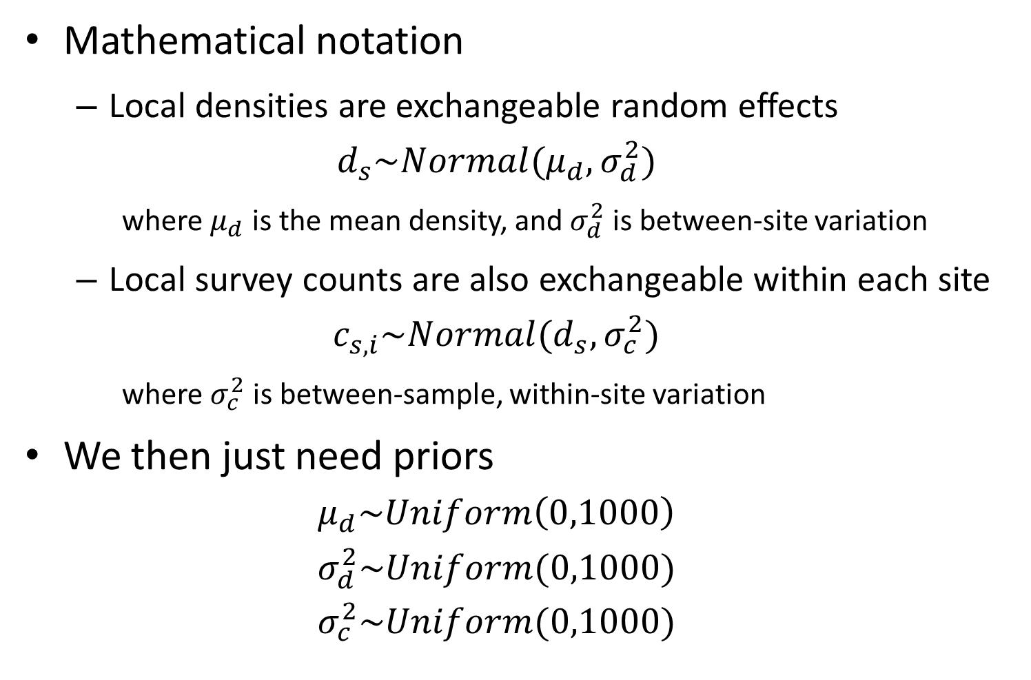
Mathematical notation
Local densities are exchangeable random effects
$$d_{s}\sim Normal(μ_{d},σ_{d}^{2})$$
where $μ_{d}$ is the mean density, and $σ_{d}^{2}$ is between-site variation
Local survey counts are also exchangeable within each site
$$c_{s,i}\sim Normal(d_{s},σ_{c}^{2})$$
where $σ_{c}^{2}$ is between-sample, within-site variation
We then just need priors
$$μ_{d}\sim Uniform\left(0,1000\right)$$
$$σ_{d}^{2}\sim Uniform(0,1000)$$
$$σ_{c}^{2}\sim Uniform(0,1000)$$

Slide 9
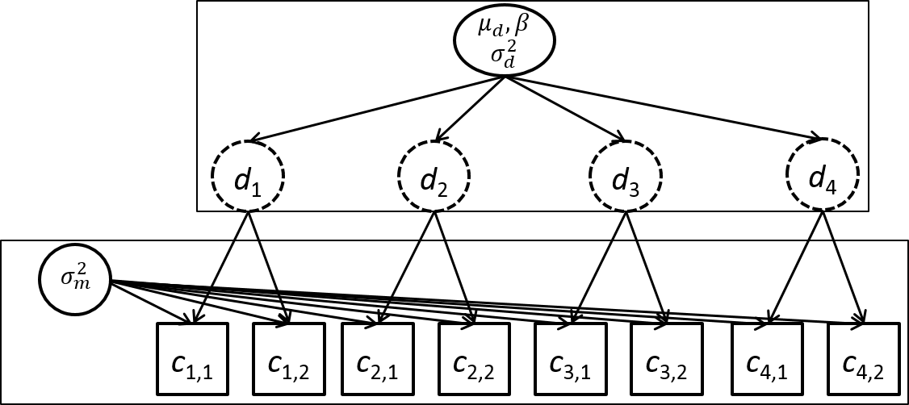

What if there’s a covariate?
Assume its measured at all chosen sites
Estimate its effect!
$$d_{s}\sim Normal(μ_{d}+βx_{s},σ_{d}^{2})$$

Slide 10
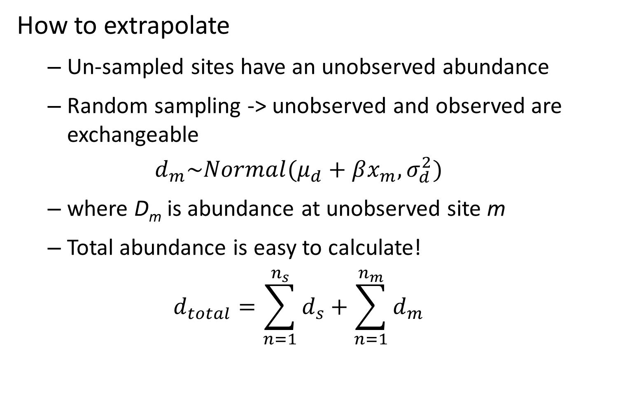
How to extrapolate
Un-sampled sites have an unobserved abundance
Random sampling -> unobserved and observed are exchangeable
$$d_{m}\sim Normal(μ_{d}+βx_{m},σ_{d}^{2})$$
where D_{m} is abundance at unobserved site m
Total abundance is easy to calculate!
$$d_{total}=\sum_{n=1}^{n_{s}}{d_{s}}+\sum_{n=1}^{n_{m}}{d_{m}}$$

Slide 11
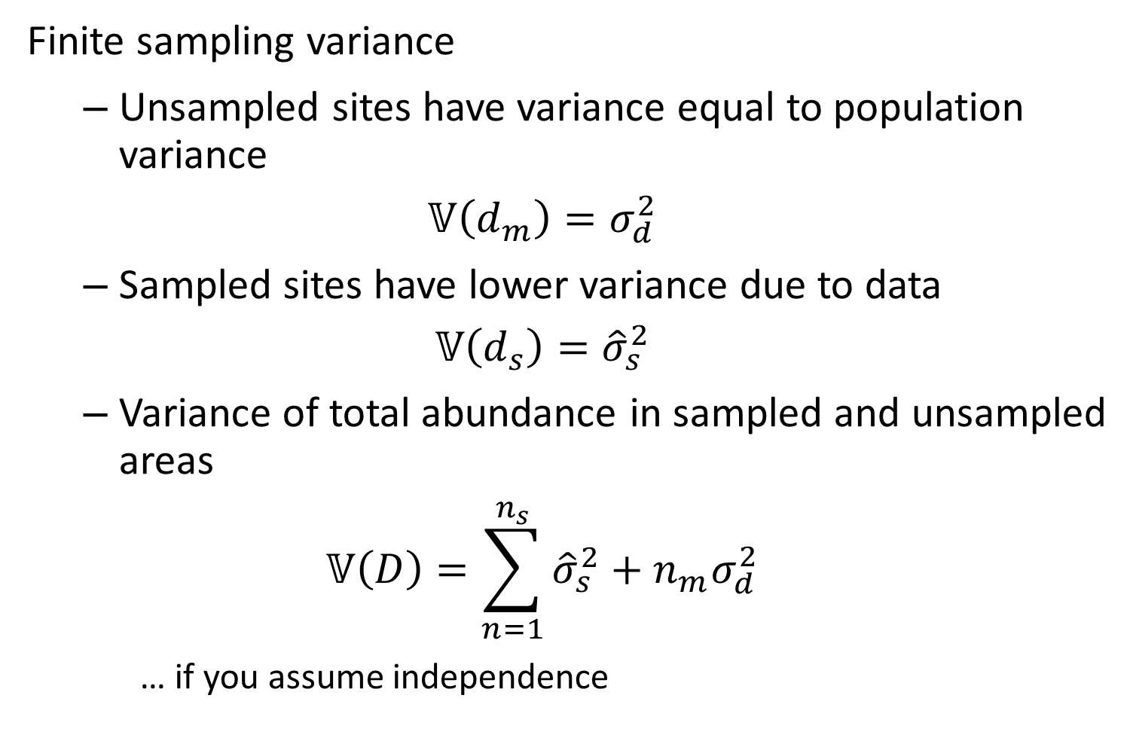
Finite sampling variance
Unsampled sites have variance equal to population variance
$$𝕍\left(d_{m}\right)=σ_{d}^{2}$$
Sampled sites have lower variance due to data
$$𝕍\left(d_{s}\right)={\hat{σ}}_{s}^{2}$$
Variance of total abundance in sampled and unsampled areas
$$𝕍\left(D\right)=\sum_{n=1}^{n_{s}}{{\hat{σ}}_{s}^{2}}+n_{m}σ_{d}^{2}$$
… if you assume independence

Slide 12
Idea #3 (best)
Make some educated guess about measurement and between-site variance, plus covariate
Literature review
Pilot study?
Optimize number of sites and samples
Not gonna discuss this further… [sampling design class]

Slide 13
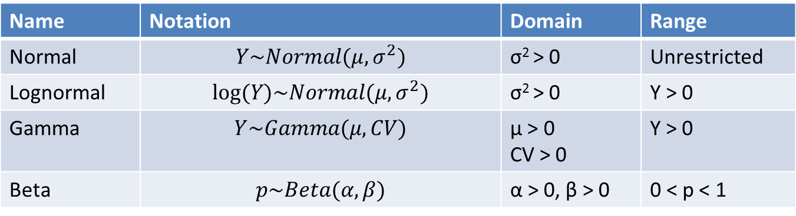
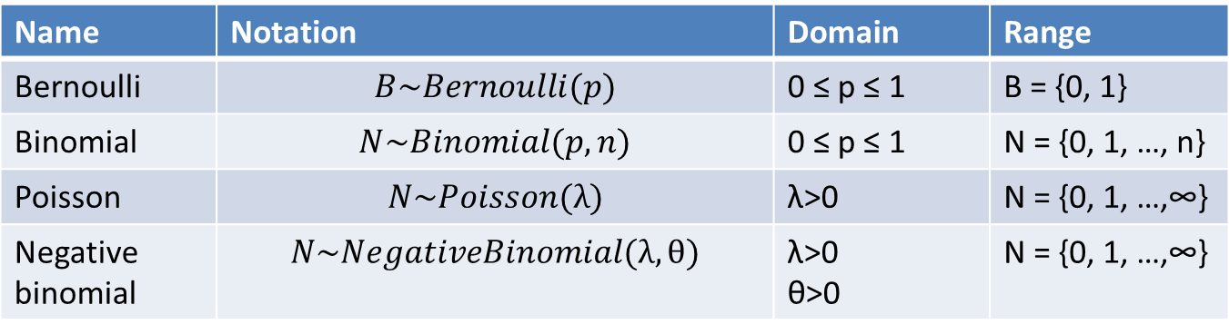
Common distributions for random effects
Discrete
Continuous
Name | Notation | Domain | Range
Bernoulli | $$B\sim Bernoulli(p)$$ | 0 ≤ p ≤ 1 | B = {0, 1}
Binomial | $$N\sim Binomial(p,n)$$ | 0 ≤ p ≤ 1 | N = {0, 1, …, n}
Poisson | $$N\sim Poisson(λ)$$ | λ>0 | N = {0, 1, …,∞}
Negative binomial | $$N\sim NegativeBinomial(λ,θ)$$ | λ>0 θ>0 | N = {0, 1, …,∞}
Name | Notation | Domain | Range
Normal | $$Y\sim Normal(μ,σ^{2})$$ | σ² > 0 | Unrestricted
Lognormal | $$log⁡(Y)\sim Normal(μ,σ^{2})$$ | σ² > 0 | Y > 0
Gamma | $$Y\sim Gamma(μ,CV)$$ | μ > 0 CV > 0 | Y > 0
Beta | $$p\sim Beta(α,β)$$ | α > 0, β > 0 | 0 < p < 1

Slide 14
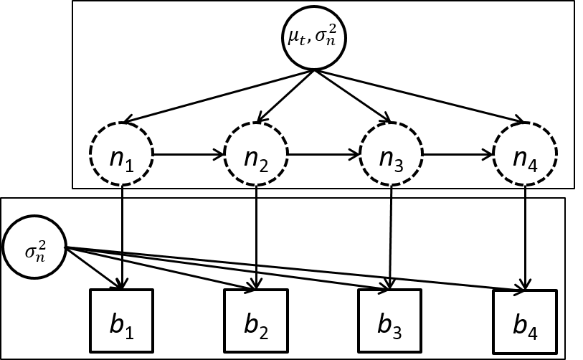
Say we’re sampling changes in amphibian abundance over time
“Time series” of samples for same site
“Open population” (has births, deaths, migrations)
Measurement + Process errors
“State-space model”

Slide 15
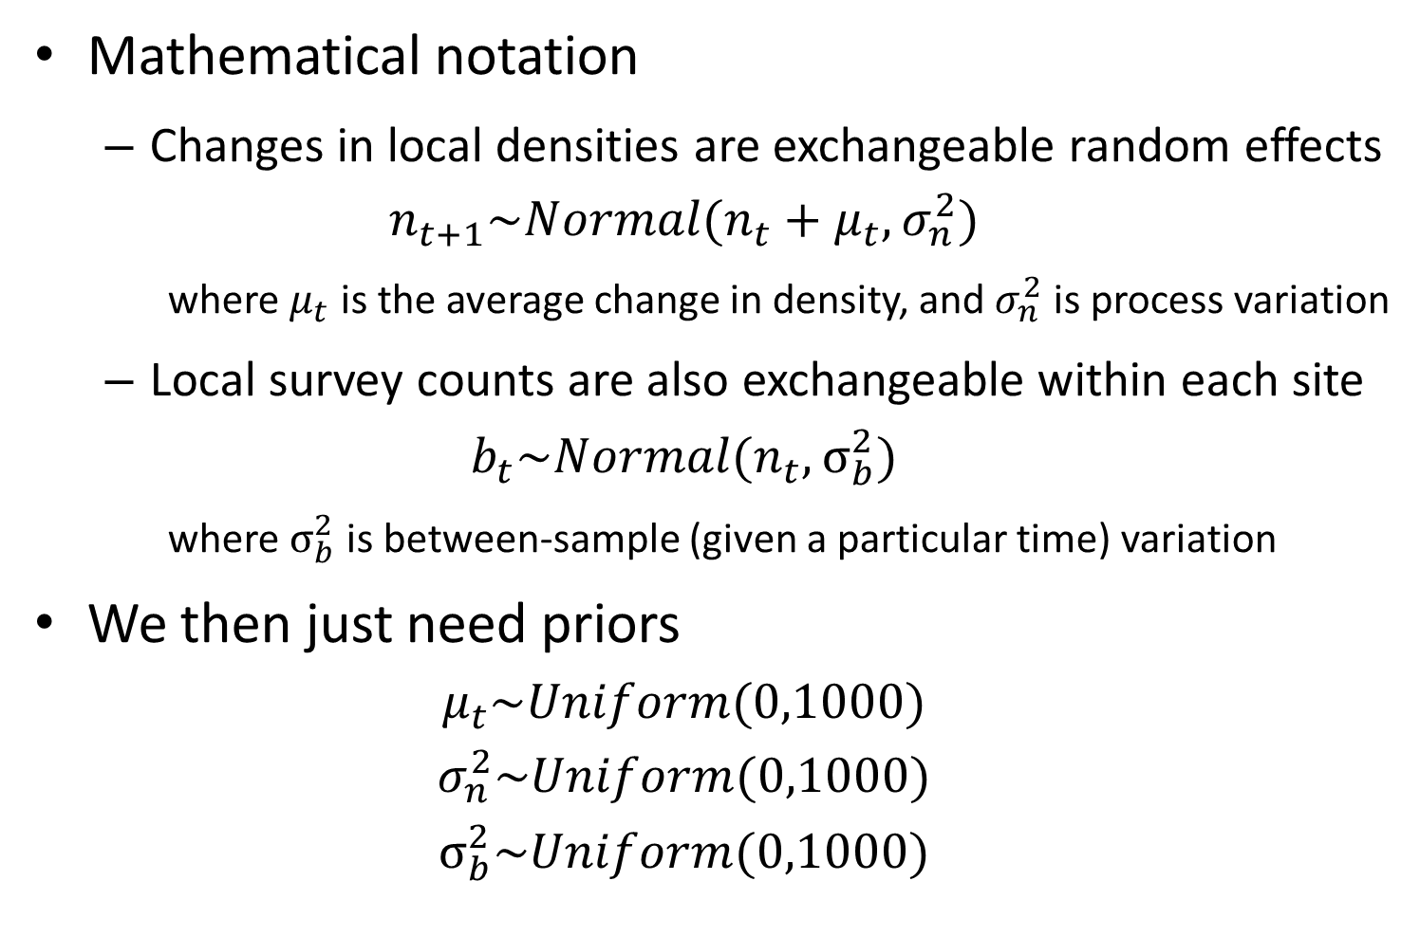
Mathematical notation
Changes in local densities are exchangeable random effects
$$n_{t+1}\sim Normal(n_{t}+μ_{t},σ_{n}^{2})$$
where $μ_{t}$ is the average change in density, and $σ_{n}^{2}$ is process variation
Local survey counts are also exchangeable within each site
$$b_{t}\sim Normal(n_{t},σ_{b}^{2})$$
where $σ_{b}^{2}$ is between-sample (given a particular time) variation
We then just need priors
$$μ_{t}\sim Uniform(0,1000)$$
$$σ_{n}^{2}\sim Uniform(0,1000)$$
$$σ_{b}^{2}\sim Uniform(0,1000)$$

Slide 16
How many parameters?
n: 4 coefficients
μ σ² σ_{m}²: 3 coefficients
… so 7 coefficients total
How much data
b: 4 data points
How does this work?!

Slide 17
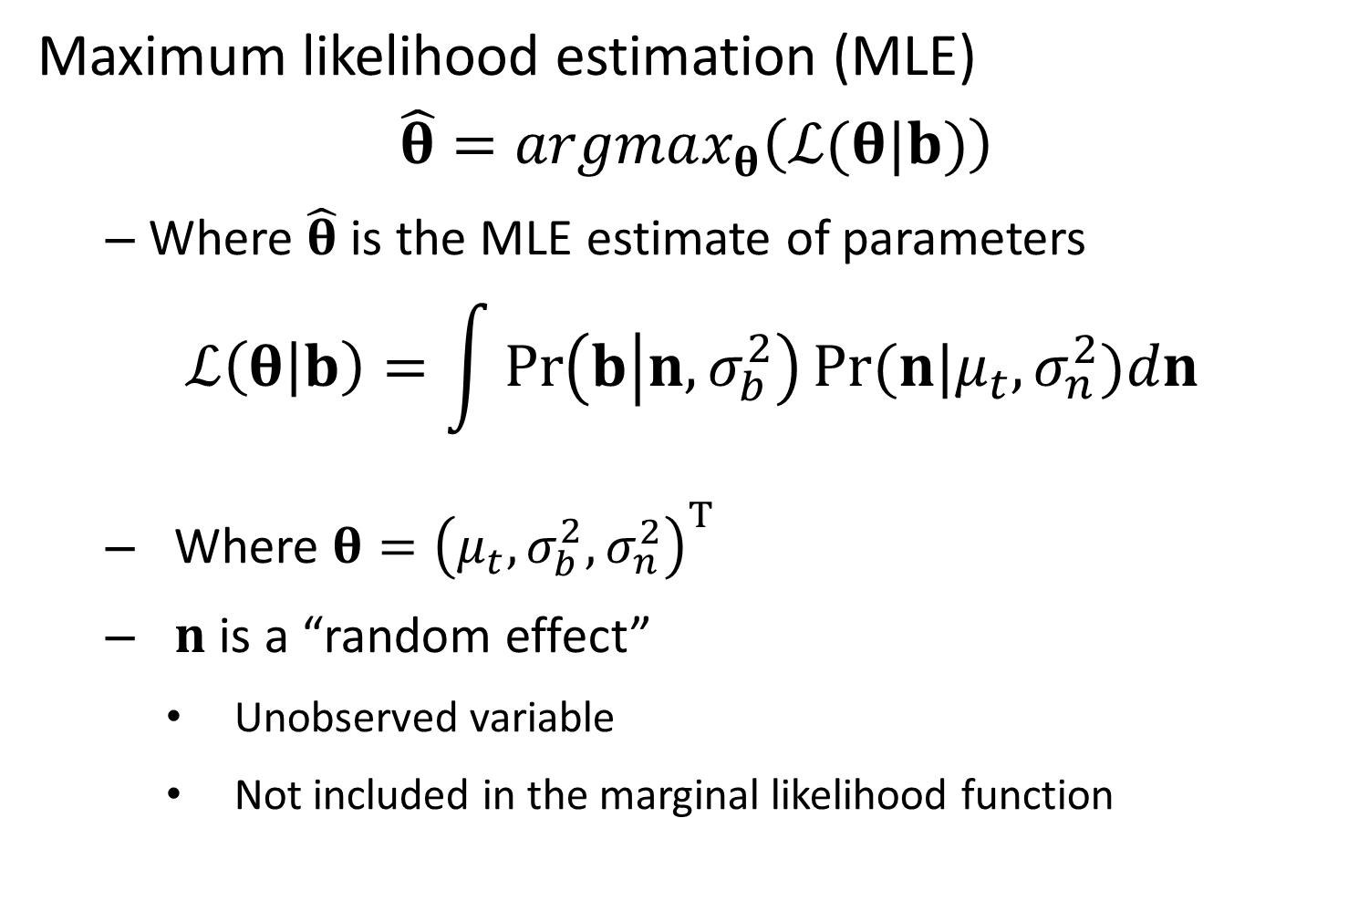
Maximum likelihood estimation (MLE)
$$\hat{θ}=argmax_{θ}\left(ℒ(θ|b)\right)$$
Where $\hat{θ}$ is the MLE estimate of parameters
$$ℒ\left(θ | b\right)=\int{\operatorname{Pr}\left(b | n,σ_{b}^{2}\right)Pr⁡(n|μ_{t},σ_{n}^{2}})dn$$
Where $θ={\left(μ_{t},σ_{b}^{2},σ_{n}^{2}\right)}^{T}$
$n$ is a “random effect”
Unobserved variable
Not included in the marginal likelihood function

Slide 18
Maximum likelihood estimation (MLE)
i.e., must “integrate” across random effects
They are never directly observed
They don’t count as “parameters” exactly
Random effects help to calculate the marginal likelihood of parameters
Fixed effects can be estimated without ever interpreting random effects

Slide 19
Meta-analysis
Summarize multiple (>5) studies/species that are treated as replicates of shared process
Explicitly use a statistical model
Incorporate confidence/quality of information from each constituent study

Slide 20
Meta-analysis example
A species is susceptible to a particular disease.
We are interested in the incidence of the disease in our marine park.
We sample 14 animals and find that 4 have the disease.
It is known that similar experiments have been conducted in 70 other marine parks around the world.
What can be said about the incidence of the disease (and its uncertainty) in our marine park?

Slide 21
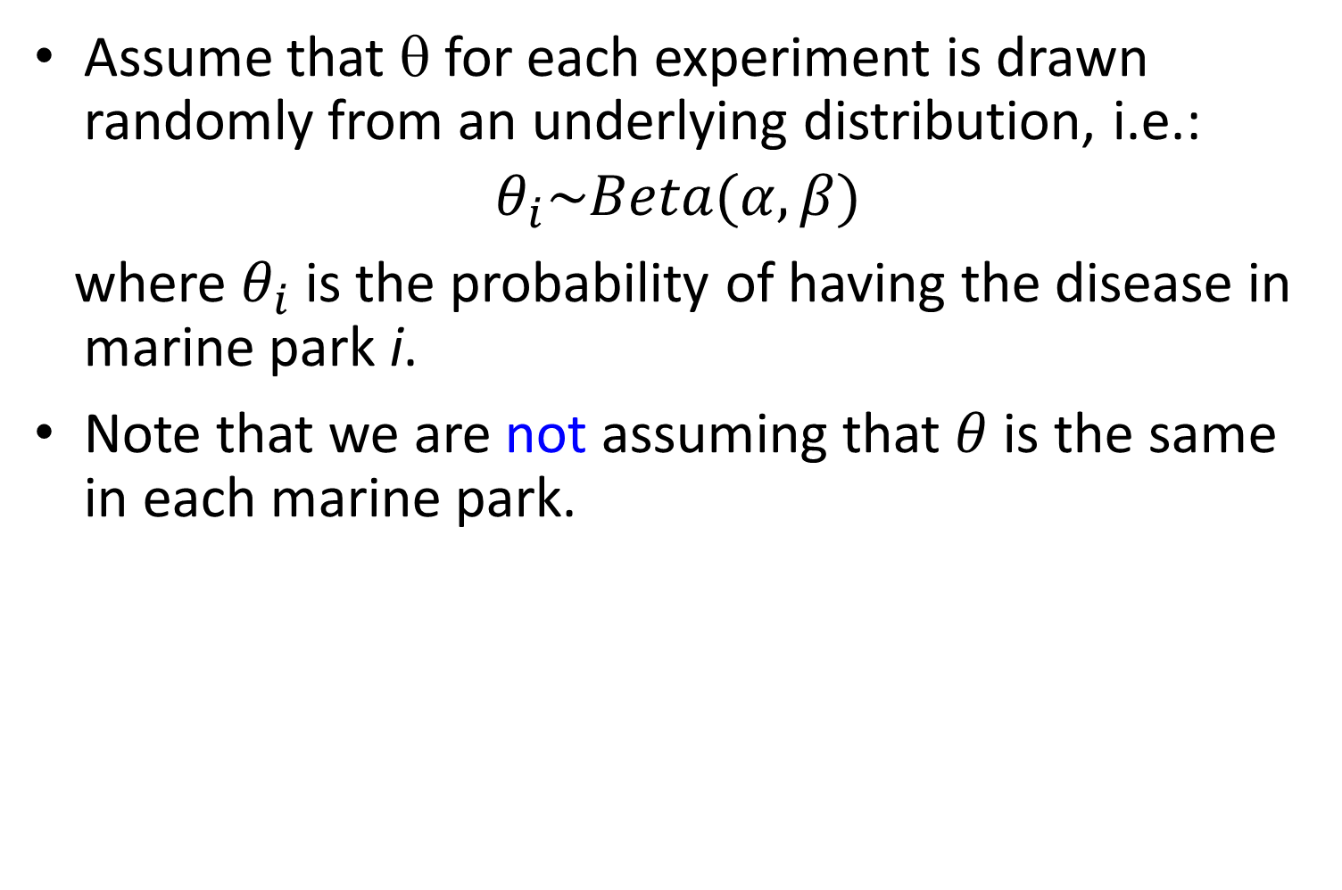
Assume that θ for each experiment is drawn randomly from an underlying distribution, i.e.:
$$θ_{i}\sim Beta(α,β)$$
where $θ_{i}$ is the probability of having the disease in marine park i.
Note that we are not assuming that $θ$ is the same in each marine park.

Slide 22


Hierarchical models
Can use GLMM
$$θ_{i}\sim Beta\left(α,β\right)$$
….
….
….
$x_{i}\sim Normal(θ_{i},σ_{x}^{2}$)
….
….
….

Slide 23
Step 1 – Distribution for data
Step 2 – Function for expected value
Distribution for random effects
$$θ_{i}\sim Beta\left(α,β\right)$$
….
….
….
$x_{i}\sim Normal(θ_{i},σ_{x}^{2}$)
….
….
….

Slide 24
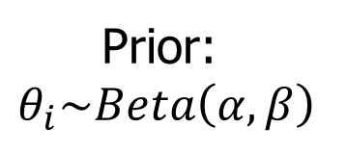
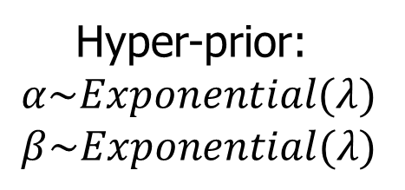
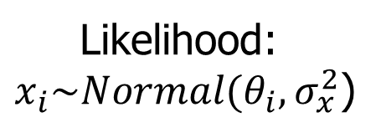
Bayesian GLMM
Also need priors
Otherwise identical
Easy because already integrating
Can use basic software
Hyper-prior:
$$α\sim Exponential(λ)$$
$$β\sim Exponential(λ)$$
Prior:
$$θ_{i}\sim Beta\left(α,β\right)$$
Covariates?
Likelihood:
$x_{i}\sim Normal(θ_{i},σ_{x}^{2}$)

